Slide 1
Lesson 6
Contour Maps and Graphs
of Functions of Two Variables

Slide 2
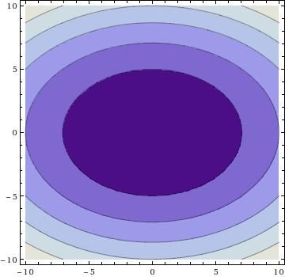
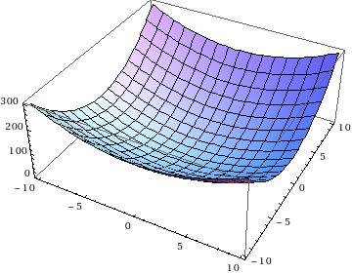
Example 1: $f(x,y) = x^{2}+2y^{2}$

Slide 3
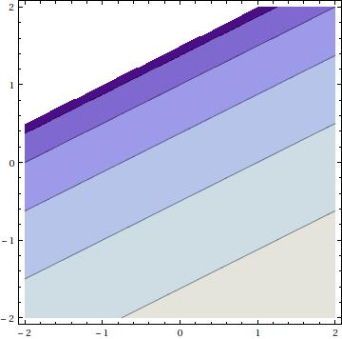
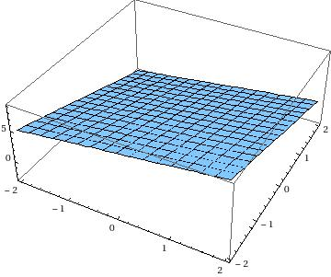
Example 2: $f(x,y)=x−2y+3$

Slide 4
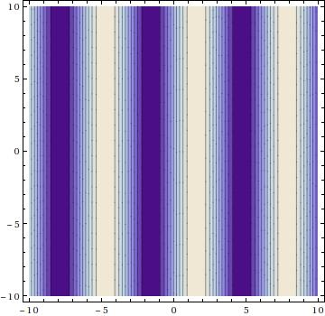
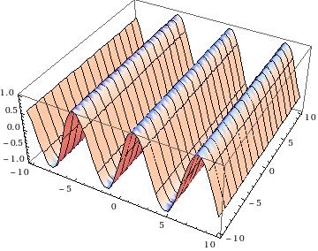
Example 3: $f(x,y)=sin⁡x$

Slide 5
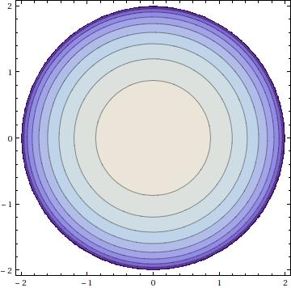
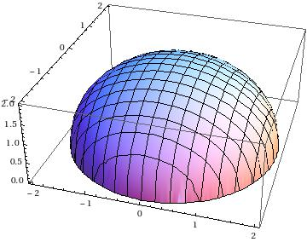
Example 4: $f(x,y)=\sqrt{4−x^{2}−y^{2}}$

Slide 6
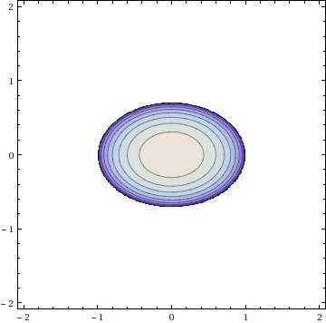
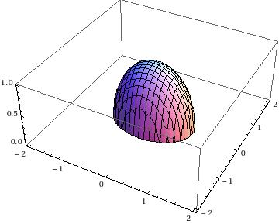
Example 5: $f(x,y)=1−x^{2}−2y^{2}$

Slide 7
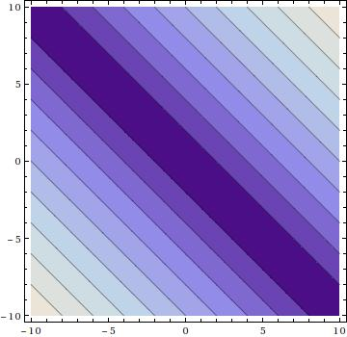
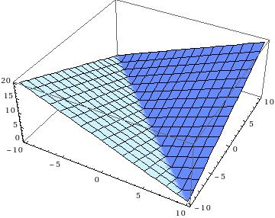
Example 6: $f(x,y)=|x+y|$

Slide 8
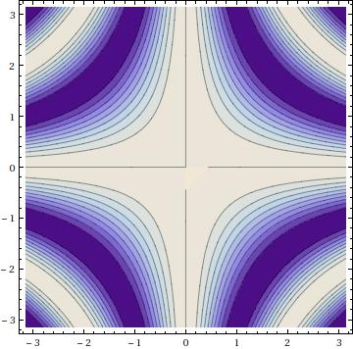
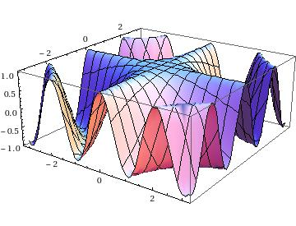
Example 7: $f(x,y)=cos⁡(xy)$

Slide 9
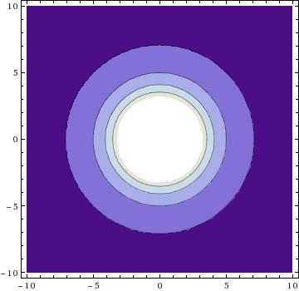
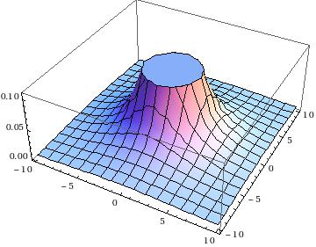
Example 8: $f(x,y)=\frac{1}{x^{2}+y^{2}}$

Slide 10
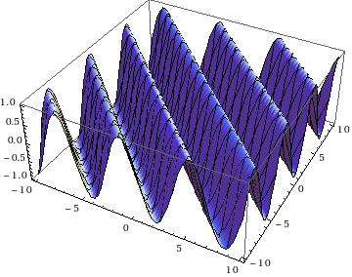
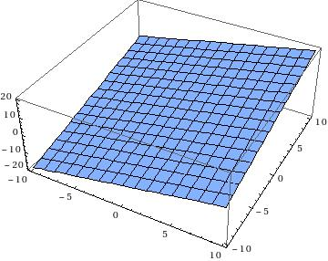
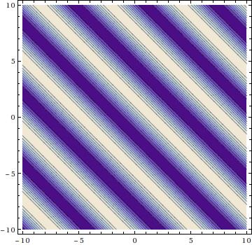
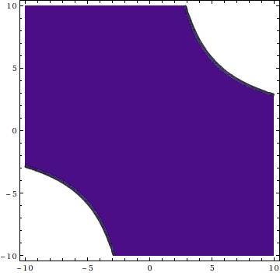
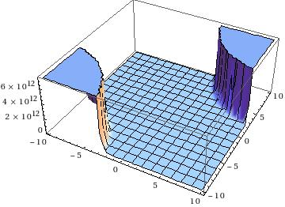
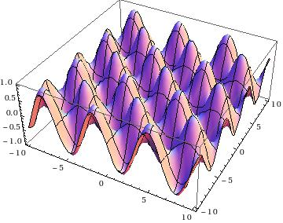
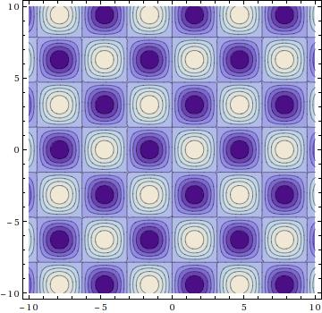
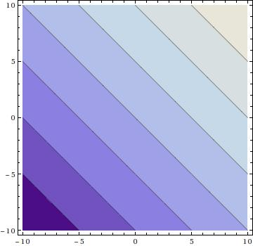
(I)
(II)
(1)
(2)
(III)
(IV)
(3)
(4)

Slide 11
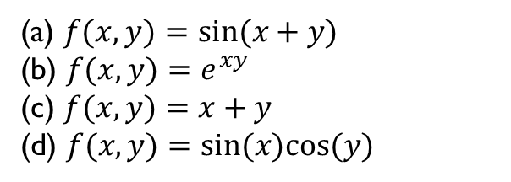
(1)
(3)
(a) $f(x,y)=sin⁡(x+y)$
(b) $f(x,y)=e^{xy}$
(c) $f(x,y)=x+y$
(d) $f(x,y)=sin⁡(x)cos⁡(y)$
(2)
(4)

